Slide 1
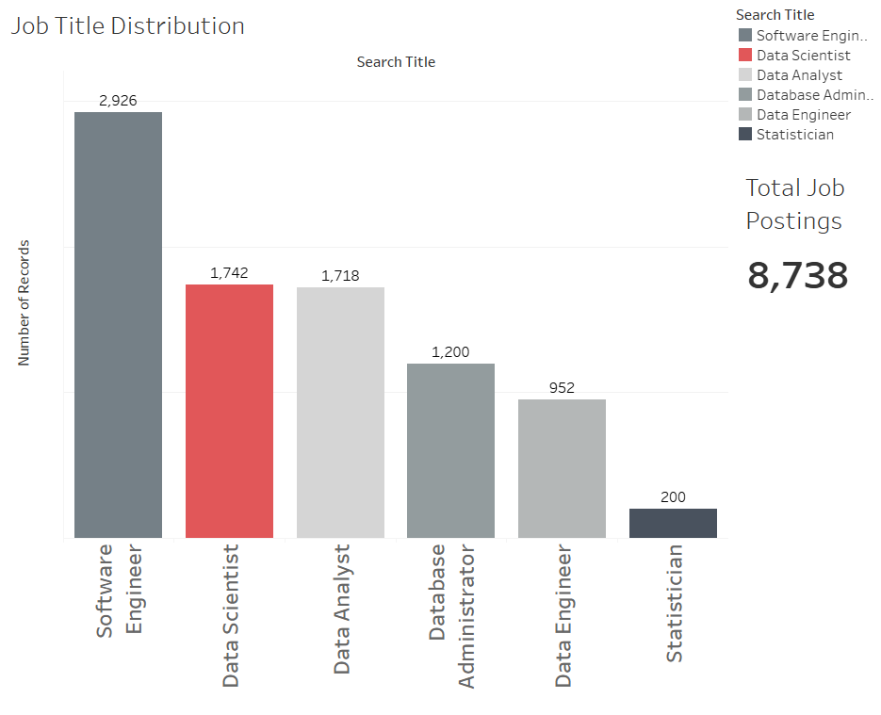
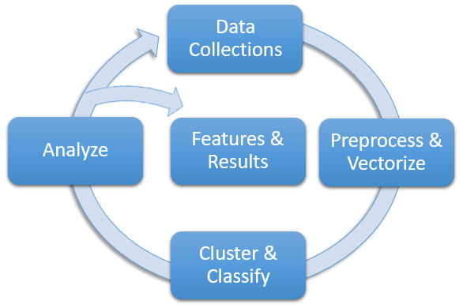
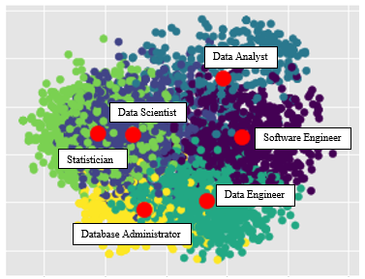

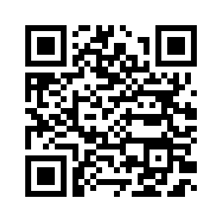


A Data Science Approach to Define a Data Scientist
Non-Cognitive Predictors of Student Success: A Predictive Validity Comparison Between Domestic and International Students
Non-Cognitive Predictors of Student Success: A Predictive Validity Comparison Between Domestic and International Students
Who or what……pick one….one in the same.
Method – visual the image that’s already there.
Move address under MSDS at bottom of middle.
Consider changing black on blue….remove italics from sentence. “is” a statistician??
Venn diagram – title with circle and add a little context
Remove key under PCA. Remove “PCA” from title. Focus on commonality of them all. Add a few description sentences under (or conclusion).
Increase font on bar chart…center numbers.
What if: only put definition in the center? Remove who ro what? Title across all three columns or just in the middle. With author underneath.
Right side…..support code, communicate, and collaborate….
Introduction
The ‘who is’ and ‘what is’ a Data Scientist is undecided - leading to unmet expectations, misfit hires, and lost time/resources for employers, employees, and applicants. Using state-of-art NLP and Machine Learning on 8,000+ job postings, we arrive at the features that define the ‘what is’ and cluster other job titles to understand the ‘who is’ a Data Scientist.
Andy Ho An Nguyen Jodi Pafford
Dr. Robert Slater
Master of Science in Data Science
Data Set Distribution by Titles
2,926
1,742
1,718
1,200
200
952
A Data Scientist is a statistician who can code, communicate, and collaborate.
Needs a title but not the one we gave it.
Data Analyst
Data Scientist
Software Engineer
Statistician
Data Engineer
Database Administrator
Write a few sentences on the meaning behind this image. There’s time for someone to read this while looking at posters
Master of Science in Data Science
Southern Methodist University
Dallas, TX 75375, USA
Interact with our data by visiting our Tableau Website
Notes:
Notes:
In Powerpoint, click View > Guides
Keep text within gutter guides.
Author list: Don’t split names onto two lines (e.g., “Jimmy [break] Smith”). If that happens, use a new line, unless you need the space. Bold the first names of anybody who’s presenting in person.
Intro/methods/result: Do not drop below font size 28, but if you have extra space, jack up the font size until the space is full.
Do not use color in the sidebars except in graphs/figures. It’ll pull attention from the center and slow interpretation for passersby.

